Slide 1
Who’s the Boss? Mark 4:1-34
BOSS
Samuel Lim
Singapore Bible College
6th March 2013
Preached for Dr. Rick Griffith, Singapore Bible College www.biblestudydownloads.com

Slide 2
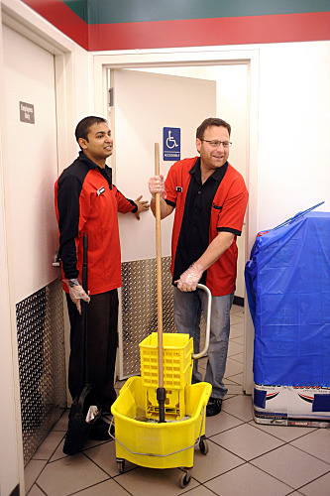
Joseph DePinto
CEO, Owner of 7-Eleven

Slide 3
Who’s the Boss? Mark 4:1-34
BOSS
What does it mean
to live with God
in charge?

Slide 4
Prepare your heart to respond to God’s Word
Mark 4:3-8

Slide 5
Prepare your heart to respond to God’s Word
A hardened heart results in
no growth
Mark 4:15

Slide 6
Prepare your heart to respond to God’s Word
An uncommitted heart results in
shallow growth
Mark 4:16-17

Slide 7
Prepare your heart to respond to God’s Word
A divided heart results in
stunted growth
Mark 4:18-19

Slide 8
Prepare your heart to respond to God’s Word
A fertile heart
results in
full growth
Mark 4:20

Slide 9
What does it mean to live with God in charge?
Prepare your heart to respond to God’s Word

Slide 10
Acknowledge God’s work in your ministry

Slide 11
Jesus is manifested in our ministry
Parable of the Lamp Mark 4:21-22
Truth is manifest in the person of Jesus Christ
Others can see Christlikeness in our ministry

Slide 12
Iron Fillings

Slide 13
Growth happens beyond our knowledge and control
Parable of the Seed Mark 4:26-29
Growth is the divine work of God
We are not the moving force behind any spiritual growth

Slide 14
James O. Fraser
Missionary to the
Lisu People in China

Slide 16
God uses small beginnings and makes it great
Parable of the Mustard Seed Mark 4:30-32
God brings multiple results from small beginnings
We are small but God is great

Slide 17
Madam Ang
Devoted her life to praying for family

Slide 19
What does it mean to live with God in charge?
BOSS
Prepare your heart for God’s Word
Acknowledge God’s work

Slide 21
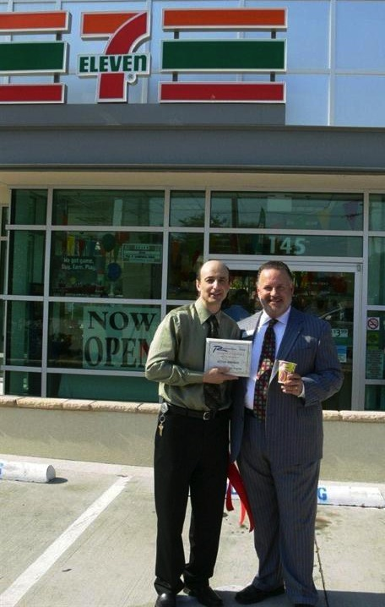
Igor Finkler

Slide 22
Black

Slide 23
NT Sermons link at biblestudydownloads.com
Get this presentation and script for free!

